Slide 1
Introduction To Compiler
Course Code: CSC 3220
Course Title: Compiler Design
Dept. of Computer Science
Faculty of Science and Technology
Lecturer No: | 2 | Week No: | 2 | Semester: | Summer 23-24
Lecturer: | Nazia Alfaz ; nazia.alfaz@aiub.edu Room: D0201B

Slide 2
Lecture Outline
Language Processing System
Different Phases of a Compiler

Slide 3
Objectives and Outcomes
Objectives:
Understand the structure of a language processing system.
Understand the structure of a compiler.
Understand the tools involved( Scanner generator, Parser generator, etc)
Outcomes:
Students should be able to understand how a language is processed step by step.
Students will analyze the phases of a compiler.

Slide 4
Language Processing System
The preprocessor modifies the source program. Later, the modified high level language is fed to a compiler. As debugging in assembly language is comparatively easier, the compiler converts the modified source program into assembly. Finally, the assembler makes the assembly code into relocatable machine code as its output.
Large programs are often compiled in pieces; therefore, the main relocatable machine code may have to be linked together with other relocatable object files and library files into the code that actually runs on the machine. The linker links all the addresses and library files into one main file. Afterwards, the loader puts together all of the executable object files into memory for execution.
Source Program
Preprocessor
Modified source program
Compiler
Target assembly program
Assembler
Relocatable machine code
Linker/ Loader
Absolute machine code
Target Program

Slide 5
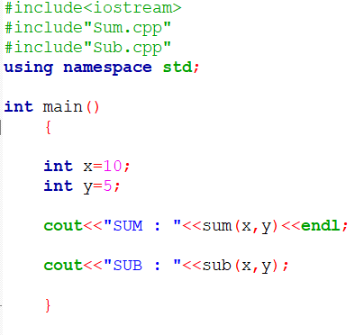
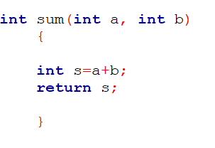
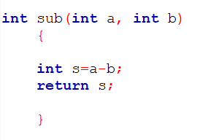
Main Program.cpp
Sum.cpp
Sub.cpp

Slide 6
The Phases of a Compiler
Source Program
1
Lexical Analyzer
2
Syntax Analyzer
3
Semantic Analyzer
Symbol-table Manager
Error Handler
4
Intermediate Code Generator
5
Code Optimizer
6
Code Generator
Target Program

Slide 7
Two main Phases of a Compiler
Analysis Phase: Breaks up a source program into constituent pieces and produces an internal representation of it called intermediate code.
Lexical Analyzer
Syntax Analyzer
Semantic Analyzer
Intermediate code generator
Synthesis Phase: Translates the intermediate code into the target program.
V. Code optimizer
VI. Code generator

Slide 8
The Phases of a Compiler
Lexical Analyzer: The first phase of a compiler is called lexical analysis or scanning. The lexical analyzer reads the stream of characters making up the source program and groups the characters into meaningful sequences called lexemes. For each lexeme, the lexical analyzer produces as output a token of the form (token-name, attribute-value). For example, suppose a source program contains the assignment statement
p o s i t i o n = i n i t i a l + r a t e * 60
The characters in this assignment could be grouped into the following lexemes and mapped into the following tokens passed on to the syntax analyzer:
p o s i t i o n is a lexeme that would be mapped into a token (id, 1), where id is an abstract symbol standing for identifier and 1 points to the symbol table entry for p o s i t i o n . The symbol-table entry for an identifier holds information about the identifier, such as its name and type.

Slide 9
The Phases of a Compiler
2. The assignment symbol = is a lexeme that is mapped into the token (=).Since this token needs no attribute-value, we have omitted the second component. We could have used any abstract symbol such as assign for the token-name, but for notational convenience we have chosen to use the lexeme itself as the name of the abstract symbol.
3. Initial is a lexeme that is mapped into the token (id, 2), where 2 points to the symbol-table entry for i n i t i a l .
4. + is a lexeme that is mapped into the token (+).
5. r a t e is a lexeme that is mapped into the token (id, 3), where 3 points to the symbol-table entry for r a t e .
6. * is a lexeme that is mapped into the token (*).
7. 60 is a lexeme that is mapped into the token (60).

Slide 10
The Phases of a Compiler
After lexical analyzer compiled the above expression the output of lexical analyzer would be
(i d , l ) (=) (id, 2) (+) (id, 3) (*) (60)
Lexical Errors: A lexical error is a mistake in a lexeme, for examples, typing tehn instead of then.

Slide 11
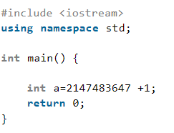
Lexical Errors
Exceeding length of identifier or numeric constants,
In the given example is an example of Lexical Error, as signed integer lies between −2,147,483,648 and 2,147,483,647 .

Slide 12
Lexical Errors
2. Unmatched string,
#include <iostream>
using namespace std;
int main() {
/* comment
cout<<“AIUB!";
return 0;
}
This is a lexical error since the ending of comment “*/” is not present but the beginning is present.

Slide 13
Lexical Errors
3. Appearance of illegal characters,
#include <iostream>
using namespace std;
int main() {
printf(“AIUB");$
return 0;
}
This is a lexical error since an illegal character $ appears at the end of the statement.

Slide 14
Lexical Errors
4. Spelling Error,
#include <iostream>
using namespace std;
int main() {
int 3num= 1234; /* spelling error as identifier
cannot start with a number*/
return 0;
}

Slide 15
Lexical Errors
5. Replacing a character with an incorrect character,
#include <iostream>
using namespace std;
int main() {
int x = 12$34; /*lexical error as '$' doesn't
belong within 0-9 range*/
return 0;
}

Slide 16
Lexical Errors
6. Removal of the character that should be present.,
#include <istream> /*missing 'o' character
hence lexical error*/
using namespace std;
int main() {
cout<<“AIUB";
return 0;
}

Slide 17
Lexical Errors
7. Transposition of two characters,
#include <iostream>
using namespace std;
int mian()
{
/* spelling of main here would be treated as a lexical
error and won't be considered as an identifier,
transposition of character 'i' and 'a'*/
return 0;
}

Slide 18
The Phases of a Compiler
Syntax Analyzer: The second phase of the compiler is syntax analysis or parsing. The parser uses the first components of the tokens produced by the lexical analyzer to create a tree-like intermediate representation that depicts the grammatical structure of the token stream. A typical representation is a syntax tree in which each interior node represents an operation and the children of the node represent the arguments of the operation. A syntax tree for the token stream ( obtain from lexical analyzer) is shown below as the output of this phase.
:=
(id, 1)
+
(id,2)
*
(id,3)
60

Slide 19
The Phases of a Compiler
The tree has an interior node labeled * with (id, 3) as its left child and the integer 60 as its right child. The node (id, 3) represents the identifier rate. The node labeled * makes it explicit that we must first multiply the value of r a t e by 60. The node labeled + indicates that we must add the result of this multiplication to the value of i n i t i a l . The root of the tree, labeled =, indicates that we must store the result of this addition into the location for the identifier p o s i t i o n . This ordering of operations is consistent with the usual conventions of arithmetic which tell us that multiplication has higher precedence than addition, and hence that the multiplication is to be performed before the addition.
Syntax Error: A grammatical error is a one that violates the (grammatical) rules of the language, for example if x = 7 y := 4 (missing then).

Slide 20
The Phases of a Compiler
Semantic Analyzer: The semantic analyzer uses the syntax tree and the information in the symbol table to check the source program for semantic consistency with the language definition. It also gathers type information and saves it in either the syntax tree or the symbol table, for subsequent use during intermediate-code generation.
Semantic analysis checks whether the parse tree constructed follows the rules of language. For example, assignment of values is between compatible data types, and adding string to an integer. Also, the semantic analyzer keeps track of identifiers, their types and expressions; whether identifiers are declared before use or not etc. In practice semantic analyzers are mainly concerned with type checking and type coercion based on type rules. The semantic analyzer produces an annotated syntax tree as an output.

Slide 21
The Phases of a Compiler
:=
(id, 1)
+
(id,2)
*
(id,3)
inttofloat
60
Conversion Action

Slide 22
The Phases of a Compiler
Semantic Errors: During compilation Semantic analyzer will recognize the following semantic errors.
Datatype mismatch
Undeclared variable
Multiple declaration of a variable in a scope
Reserved identifier misuse

Slide 23
Lecture References
A. Aho, R. Sethi and J. Ullman, Compilers: Principles, Techniques and Tools
(The Dragon Book), [ Second Edition]

Slide 24
References
A. Aho, R. Sethi and J. Ullman, Compilers: Principles, Techniques and Tools(The Dragon Book), [ Second Edition]
Principles of Compiler Design (2nd Revised Edition 2009) A. A. Puntambekar
Basics of Compiler Design Torben Mogensen

